Slide 1
EXP 5

Slide 2



Semaphore
A synchronization tool
A semaphore S is an integer variable that,
apart from initialization,
is accessed only through two standard atomic operations:
wait () and
signal ().
wait () operation = originally termed P
from the Dutch proberen,
Meaning "to test“ or “to attempt”
signal() operation = originally called V
from verhogen,
Meaning "to increment"

Slide 3
Semaphore
Classical Definition of Wait-
wait(S) {
while S <= 0
; II no-op
s--;
}
The testing of the integer value of S (S<=0), as well as its possible modification (S--), must be executed without interruption.

Slide 4
Semaphore
Classical Definition of Signal-
signal(S) {
S++;
}
All modifications to the integer value of the semaphore in the wait () and signal() operations must be executed indivisibly.
That is, when one process modifies the semaphore value, no other process can simultaneously modify that same semaphore value.

Slide 5
Usage of Semaphore
To Deal with n-process Critical Section Problem, i.e Mutual Exclusion
To Solve Synchronization Problem

Slide 6
Types of Semaphore
Types of Semaphores
Counting
Binary
Counting Semaphore-
The value of a counting semaphore can range over an unrestricted domain.
Binary Semaphore-
The value of a binary semaphore can range only between 0 and 1.
Also known as mutex locks, as they are locks that provide mutual exclusion.

Slide 7
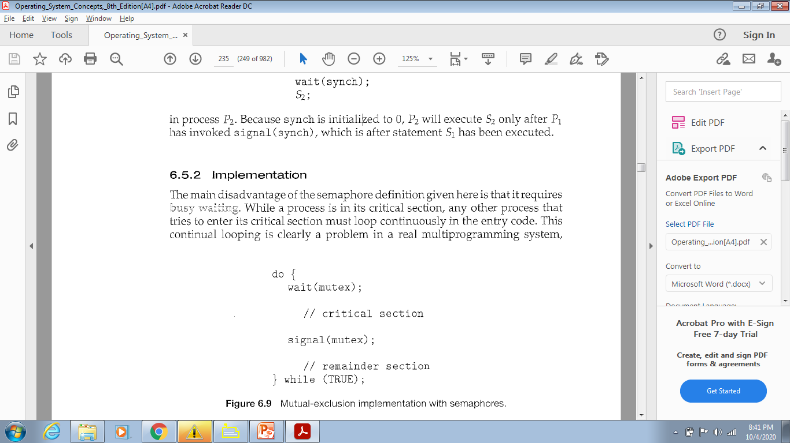
Binary Semaphore
Mutual Exclusion using Binary Semaphore
Used to deal with the critical-section problem for multiple processes.
Processes share a semaphore, mutex, initialized to 1.

Slide 8
Counting Semaphore
Used to control access to a given resource consisting of a finite number of instances.
The semaphore is initialized to the number of resources available.

Slide 9
Counting Semaphore
Each process that wishes to use a resource performs a wait() operation on the semaphore ,
thereby decrementing the count.
When a process releases a resource, it performs a signal() operation
incrementing the count.
When the count for the semaphore goes to 0, all resources are being used.
After that, processes that wish to use a resource will block until the count becomes greater than 0.

Slide 10
ISRO | ISRO CS 2017 – May | Question 78
At particular time, the value of a counting semaphore is 10, it will become 7 after: (a) 3 V operations (b) 3 P operations (c) 5 V operations and 2 P operations (d) 2 V operations and 5 P operations
Which of the following option is correct? (A) Only (b) (B) Only(d) (C) Both (b) and (d) (D) None of these

Slide 11
ISRO | ISRO CS 2017 – May | Question 78
At particular time, the value of a counting semaphore is 10, it will become 7 after: (a) 3 V operations (b) 3 P operations (c) 5 V operations and 2 P operations (d) 2 V operations and 5 P operations Which of the following option is correct? (A) Only (b) (B) Only(d) (C) Both (b) and (d) (D) None of these Answer: (C) Explanation: P: Wait operation decrements the value of the counting semaphore by 1. V: Signal operation increments the value of counting semaphore by 1. Current value of the counting semaphore = 10 a) after 3 P operations, value of semaphore = 10-3 = 7 d) after 2 v operations, and 5 operations value of semaphore = 10 + 2 – 5 = 7 Hence option (C) is correct.

Slide 12
UGC-NET | UGC NET CS 2018 July – II | Question 51
At a particular time of computation, the value of a counting semaphore is 10. Then 12 P operations and “x” V operations were performed on this semaphore. If the final value of semaphore is 7, x will be: (A) 8 (B) 9 (C) 10 (D) 11

Slide 13
UGC-NET | UGC NET CS 2018 July – II | Question 51
At a particular time of computation, the value of a counting semaphore is 10. Then 12 P operations and “x” V operations were performed on this semaphore. If the final value of semaphore is 7, x will be: (A) 8 (B) 9 (C) 10 (D) 11 Answer: (B) Explanation: Intially the value of a counting semaphore is 10 Now 12 P operation are performed. Now counting semaphore value = -2 “x” V operations were performed on this semaphore and final value of counting semaphore = 7 i.e x + (-2) = 7 x = 9. So, option (C) is correct.

Slide 14
Semaphore
We can also use semaphores to solve various synchronization problems.
Consider two concurrently running processes:
P1 with a statement S1
P2 with a statement S2 .
Suppose we require that S2 be executed only after S1 has completed.

Slide 15
Semaphore
Let P1 and P2 share a common semaphore synch, initialized to 0
Statements inserted in P1
S1;
signal(synch) ;
Statements inserted in P2
wait(synch);
S2;
Because synch is initialized to 0,
P2 will execute S2 only after P1 has invoked signal (synch), which is after statement S1 has been executed.
Else P2 will caught in infinte loop inside wait() fn

Slide 16
Busy Waiting
Must guarantee that no two processes can execute the wait() and signal() on the same semaphore at the same time
Thus, the implementation becomes the critical section problem
the wait and signal code are placed in the critical section

Slide 17
Busy Waiting
While a process is in its critical section,
any other process that tries to enter its critical section must loop continuously in the entry code=>Infinite Loop
This continual looping is clearly a problem in a real multiprogramming system where a single CPU is shared among many processes.
Busy waiting wastes CPU cycles that some other process might be able to use productively.

Slide 18
Busy Waiting
Disadvantage
Busy Waiting
Software Solutions i.e. Algo 1, Algo2, Peterson’s Solution and Semaphore definition
all suffer from Busy Waiting

Slide 19
Busy Waiting
While a process is in its critical section,
This type of semaphore is also called a Spinlock
The process "spins" while waiting for the lock.
Advantage of Spinlocks-
No context switch is required when a process must wait on a lock, and a context switch may take considerable time.

Slide 20
Busy Waiting
Thus, when locks are expected to be held for short times, spinlocks are useful;
Often employed on multiprocessor systems where
one thread can "spin" on one processor while
another thread performs its critical section on another processor.

Slide 21
Busy Waiting
Could now have busy waiting in critical section implementation
But implementation code is short
Little busy waiting if critical section rarely occupied
Note that applications may spend lots of time in critical sections and therefore this is not a good solution

Slide 22
Semaphore Implementation with no Busy waiting

Slide 23
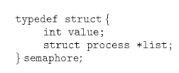
Semaphore Definition
Define a semaphore as a "C' struct
Each semaphore has
an integer value
a list of processes list.

Slide 24
Semaphore Definition
With each semaphore there is an associated waiting queue
Each entry in a waiting queue has two data items:
value (of type integer)
pointer to next record in the list

Slide 25
Semaphore Definition
Wait()
When a process must wait on a semaphore, it is added to the list of processes.
Signal()
A signal() operation removes one process from the list of waiting processes and awakens that process

Slide 26
Implementation with no busy waiting
We modify the definition of the wait() and signal() semaphore operations.
When a process executes the wait () operation and finds that the semaphore value is not positive, it must wait.
Rather than busy waiting, the process can block itself.

Slide 27
Implementation with no busy waiting
Two operations:
block
wakeup

Slide 28
Implementation with no busy waiting
Two operations:
block –
The block() operation suspends the process that invokes it.
place the process invoking the operation on the waiting queue associated with the semaphore
The state of the process is switched to the waiting state.
Control transferred to the CPU scheduler, which selects another process to execute.

Slide 29
Implementation with no busy waiting
wakeup –
A process that is blocked, waiting on a semaphore S, should be restarted
when some other process executes a signal() operation.
The process is restarted by a wakeup () operation

Slide 30
Implementation with no busy waiting
wakeup –
The wakeup(P) operation resumes the execution of a blocked process P.
Remove one of processes in the waiting queue and place it in the ready queue
Changes the process state from waiting to ready
These two operations are provided by the operating system as basic system calls.

Slide 31
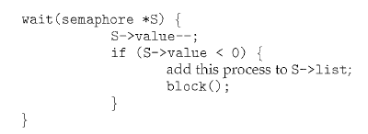
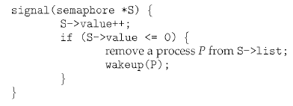
Implementation with no busy waiting

Slide 32
Implementation with no busy waiting
Semaphore values may be negative,
If a semaphore value is negative, its magnitude is the no of processes waiting on that semaphore.
Semaphore values are never negative under the classical definition of semaphores with busy waiting.

Slide 33
Implementation with no busy waiting
The list of waiting processes can be easily implemented by
a link field in each process control block (PCB).
Each semaphore contains
an integer value and
a pointer to a list of PCBs.
One way to add and remove processes from the list
so as to ensure bounded waiting is to use a FIFO queue,
where the semaphore contains both head and tail pointers to the queue.
In general, the list can use any queueing strategy.

Slide 34
Deadlock and Starvation
Deadlock – two or more processes are waiting indefinitely for an event that can be caused by only one of the waiting processes
The event in question is execution of signal operation
Let S and Q be two semaphores initialized to 1
P₀ P₁
wait(S); wait(Q);
wait(Q); wait(S);
... ...
signal(S); signal(Q);
signal(Q); signal(S);

Slide 35
Deadlock and Starvation
P₀ P₁
wait(S); wait(Q);
wait(Q); wait(S);
... ...
signal(S); signal(Q);
signal(Q); signal(S);
P0 executes wait(S) then P1 executes wait(Q)
When P0 executes wait(Q), it must wait until P1 executes signal(Q)
When P1 executes wait(S), it must wait until P0 executes signal (S)

Slide 36
Deadlock and Starvation
Deadlock-Every process in the set is waiting for an event that can be caused only by another process in the set
Starvation – indefinite blocking
A process may never be removed from the semaphore queue in which it is suspended
Priority Inversion – Scheduling problem when lower-priority process holds a lock needed by higher-priority process
Solved via priority- inheritance protocol

Slide 37
Classical Problems of Synchronization
Classical problems used to test newly-proposed synchronization schemes
Bounded-Buffer Problem
Readers and Writers Problem
Dining-Philosophers Problem

Slide 38
Bounded-Buffer Problem
n buffers, each can hold one item
Semaphore mutex ->Binary Semaphore
Provides mutual exclusion for access to the buffer pool
initialized to the value 1
Semaphore full ->Counting Semaphore
Counts no of full buffers
initialized to the value 0
Semaphore empty ->Counting Semaphore
Counts no of empty buffers
initialized to the value n
Assuming Buffer is empty

Slide 39
Bounded-Buffer Problem
The structure of the producer process
do {
... /* produce an item in next_produced */
...
wait(empty);
wait(mutex);
... /* add next produced to the buffer */
...
signal(mutex);
signal(full);
} while (true);
Semaphore mutex
initialized to the value 1
Semaphore full
initialized to the value 0
Semaphore empty
initialized to the value n

Slide 40
Bounded-Buffer Problem
The structure of the consumer process
Do {
wait(full);
wait(mutex);
... /* remove an item from buffer to next_consumed */
...
signal(mutex);
signal(empty);
... /* consume the item in next consumed */
... } while (true);
Semaphore mutex
initialized to the value 1
Semaphore full
initialized to the value 0
Semaphore empty
initialized to the value n

Slide 41
Readers-Writers Problem
A data set/object/File/Record is shared among a number of concurrent processes
Readers – only read the data set; they do not perform any updates
Writers – can both read and write/Want to update
Problem – allow multiple readers to read at the same time, no adverse effects
Only one single writer can access the shared data at the same time
If a writer and some other process(reader/writer) access shared object simultaneously chaos may ensue
Requirements
Writers must have exclusive access to the shared object

Slide 42
Readers-Writers Problem
Several variations of how readers and writers are considered – all involve some form of priorities
First Reader Writer Problem-
No reader will be kept waiting unless a writer has already obtained permission to use the shared object.
No reader should wait for other readers
Second Reader Writer Problem-
Once a writer is ready , that writer performs its write as soon as possible
If a writer is waiting to access the object, no new readers may start reading

Slide 43
Readers-Writers Problem
Solution to First Reader Writer Problem
Shared Data
Data set
Semaphore rw_mutex
Common to both reader and writers
Mutual Exclusion semaphore for the writers
Also used by 1st or Last Reader that enters or exits CS
initialized to 1
Semaphore mutex
To ensure ME when variable readcount is updated
initialized to 1
Integer read_count initialized to 0

Slide 44
Readers-Writers Problem
Semaphore rw_mutex
Mutual Exclusion for the writers
initialized to 1
Semaphore mutex
ME for readcount update
initialized to 1
read_count initialized to 0
The structure of a writer process
do { wait(rw_mutex);
... /* writing is performed */
...
signal(rw_mutex);
} while (true);

Slide 45
Readers-Writers Problem
The structure of a reader process
do { wait(mutex); read_count++; if (read_count == 1)
wait(rw_mutex);
signal(mutex);
... /* reading is performed */
...
wait(mutex); read count--; if (read_count == 0)
signal(rw_mutex);
signal(mutex);
} while (true);
Semaphore rw_mutex
Mutual Exclusion for the writers
initialized to 1
Semaphore mutex
ME for readcount update
initialized to 1
read_count initialized to 0

Slide 46
Readers-Writers Problem
Both Soln may lead to Starvation
First Reader Writer Problem-
Writers may starve
Second Reader Writer Problem-
Readers may starve
Problem is solved on some systems by kernel providing reader-writer locks

